Slide 1
AWS Security: KMS, WAF, and Shield
Advanced Cloud Security

Slide 2
Introduction to AWS Security
AWS Security is based on the Shared Responsibility Model.
AWS provides built-in security tools like KMS, WAF, and Shield to help protect applications and data.
Security services help in
encryption,
access control, and
DDoS protection.

Slide 3

AWS Key Management Service (KMS)
AWS KMS is a managed service for creating and managing encryption keys.
It supports AWS services like S3, EBS, and RDS for data encryption.
Key policies and IAM permissions control access to keys.
Integration with CloudTrail for logging key usage.

Slide 4
How AWS KMS Works
Uses Customer Master Keys (CMKs) to encrypt and decrypt data.
Supports Automatic Key Rotation for security.
Envelope Encryption: KMS encrypts a data key, which then encrypts the data.
Integrated with AWS services like Lambda, S3, RDS, and CloudTrail.

Slide 5
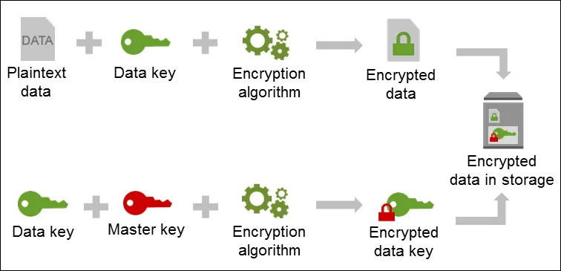

Slide 6
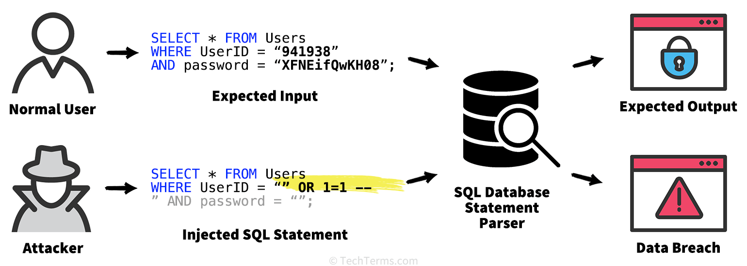
What is SQL Injection?

Slide 7
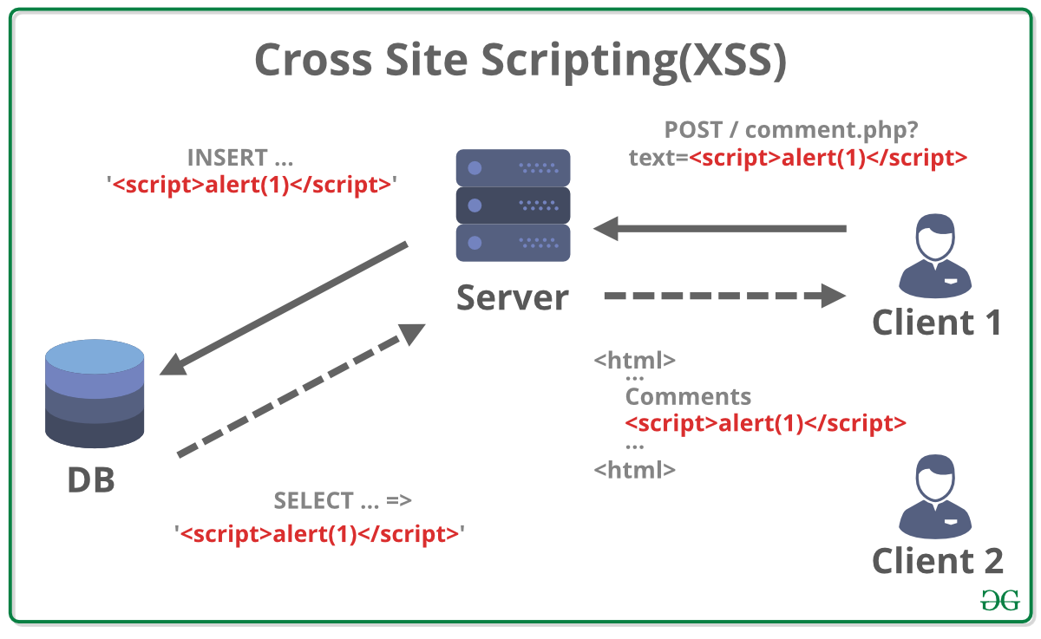

Slide 8
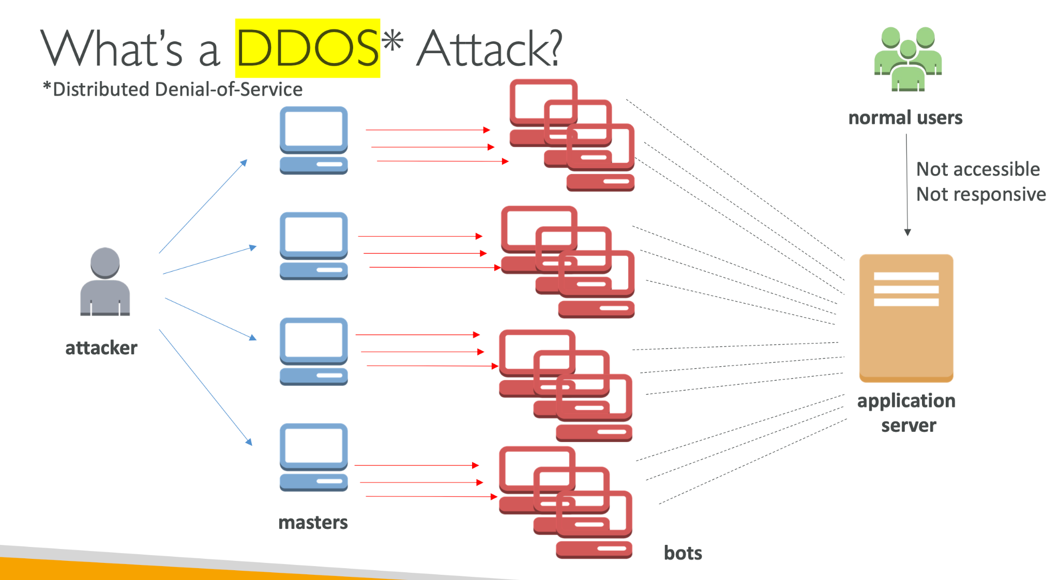

Slide 9
AWS Web Application Firewall (WAF)
AWS WAF protects applications from SQL Injection, XSS, and DDoS attacks.
Works with ALB, API Gateway, and CloudFront.
Uses WebACLs (Web Access Control Lists) for filtering requests.
Can block, allow, or monitor requests based on rules.

Slide 10
How AWS WAF Works
WebACL Rules define what traffic is allowed or blocked.
Managed Rules help block common threats.
Rate-based rules protect against brute force and DDoS attacks.
Works with Shield for enhanced DDoS protection.

Slide 11
AWS Shield for DDoS Protection
AWS Shield provides DDoS protection for applications.
Two types:
AWS Shield Standard (free, automatic protection)
AWS Shield Advanced (paid, 24/7 response, insurance)
Integrated with CloudFront, Route 53, and WAF.

Slide 12
AWS Security Best Practices
Enable AWS Shield and WAF for web applications.
Use KMS for encrypting sensitive data.
Implement IAM policies with least privilege access.
Monitor security events using CloudWatch and CloudTrail.
Regularly update WAF rules to prevent new threats.

Slide 13
Summary
AWS KMS encrypts and manages keys securely.
AWS WAF protects applications from common web threats.
AWS Shield provides DDoS mitigation.
Security best practices involve encryption, monitoring, and access control.

Slide 14


